Slide 1

Docker 101

Slide 2
Outline
Containerization
What is Docker?
Docker container
Docker images
Dockerfile
Docker network
Not mentioned

Slide 3
Software development has changed
Before: | Now:
monolithic applications | distributed system
slowly scaling up ⇒ develop and deploy in longer period | quick scaling up ⇒ develop and deploy more quickly
simple and lightweight software stack | complex with multiple software stacks: languages, framework, database
deploy on single platform | deploy on different platforms

Slide 4
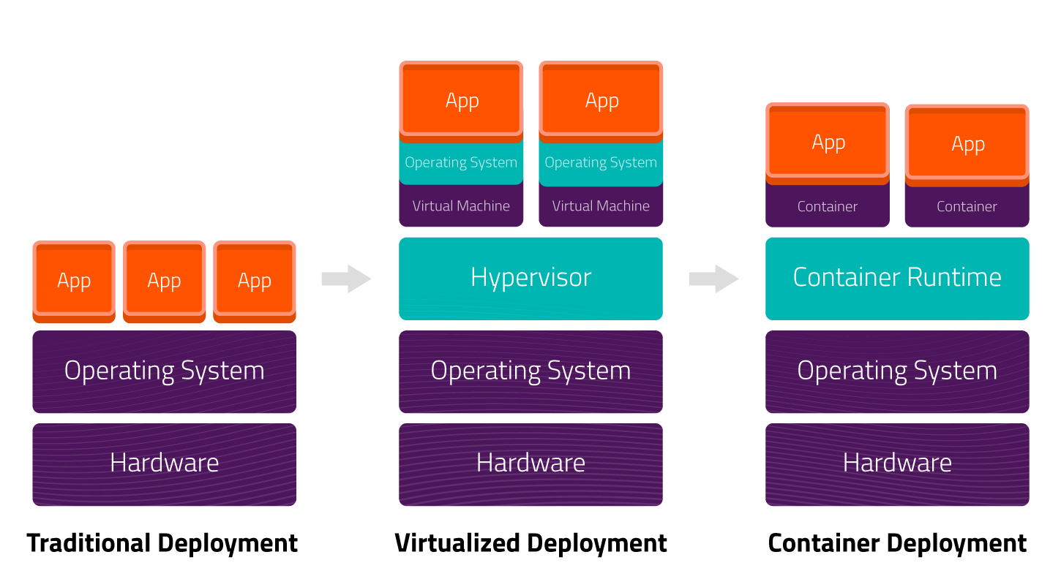
Containerization
Notes:
isolate environment ⇒ faster setup
Due to isolated environment, grab to different environment to run without more effot.
Containers are isolated, but share OS kernel and, where appropriate, bins/libraries
Linux OS run Linux container, Win OS runs Win containers.
57mb ubuntu image vs 1Gb ubuntu iso.

Slide 5
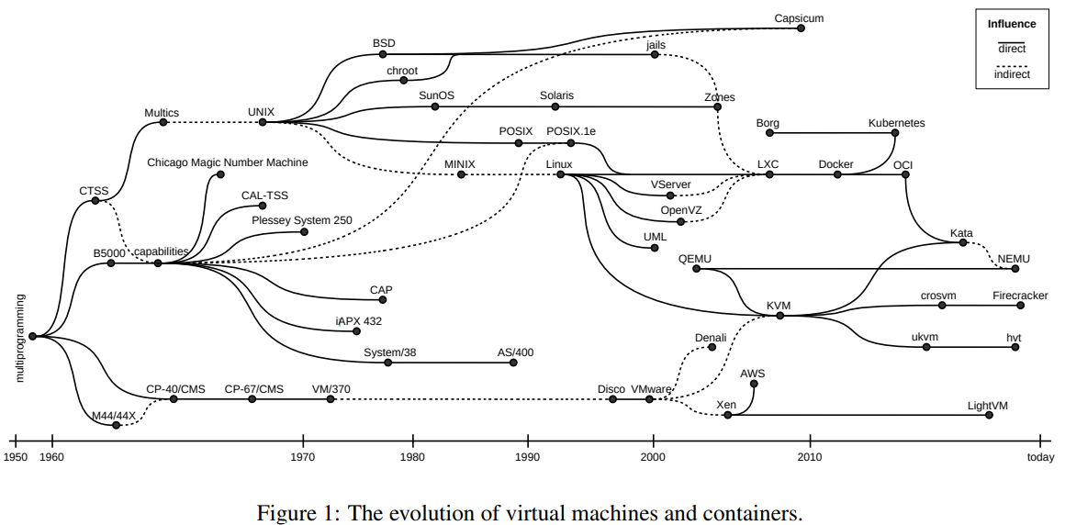
History

Slide 6
What is Docker?
Docker is an open containerization platform for developing, shipping, and running applications.
Original author(s): Solomon Hykes
Developer(s): Docker, Inc.
Initial release: March 20, 2013.
Stable release 27.0.2 - 26 June 2024
Written in Go.
Notes:
Solomon Hykes is the Founder, Chief Technology Officer and Chief Architect of Docker and the creator of the Docker open source initiative
Born in 1983, NewYork, US. Now in silicon valley.

Slide 7
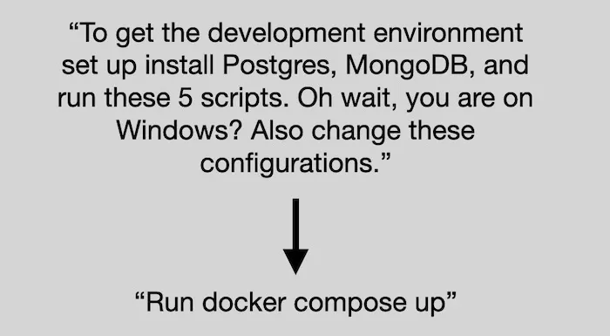
Goal
For new developer,
git clone …
And

Slide 8
Run first container
Hello World
In your Docker environment, just run the following command:
lou@vostro:~/101/docker$ docker run busybox echo hello world
Unable to find image 'busybox:latest' locally
latest: Pulling from library/busybox
ec562eabd705: Pull complete
Digest: sha256:9ae97d36d26566ff84e8893c64a6dc4fe8ca6d1144bf5b87b2b85a32def253c7
Status: Downloaded newer image for busybox:latest
hello world

Slide 9
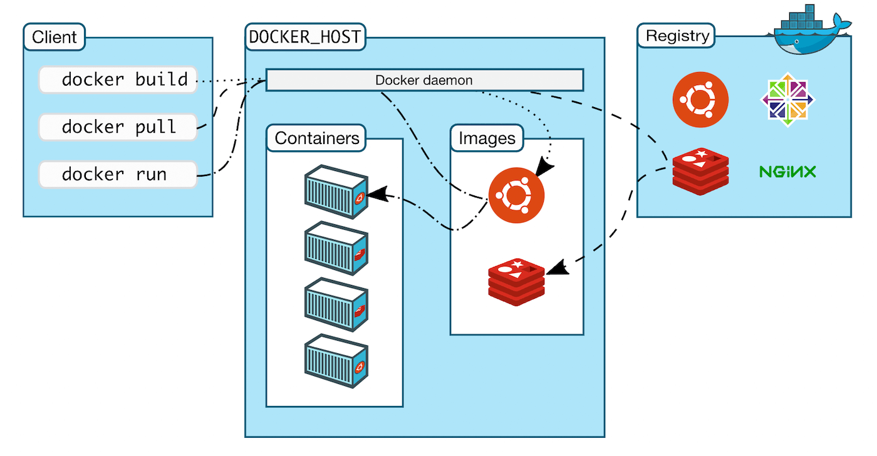
What already happen?
2
3
1
4
5

Slide 10
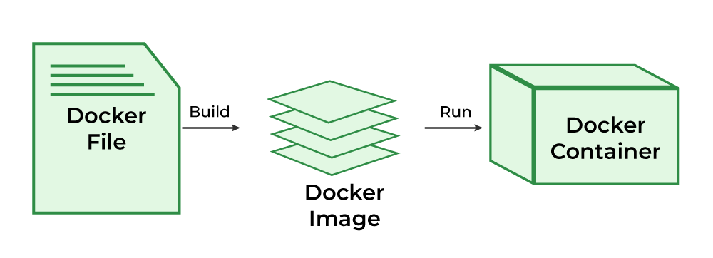
Working Sequence

Slide 11
Run a different container
lou@vostro:~/101/docker/compileC$ docker run -it time_display
Time program by Docker:
Fri Jun 28 02:39:04 2024
Fri Jun 28 02:39:05 2024
Fri Jun 28 02:39:06 2024
Fri Jun 28 02:39:07 2024

Slide 12
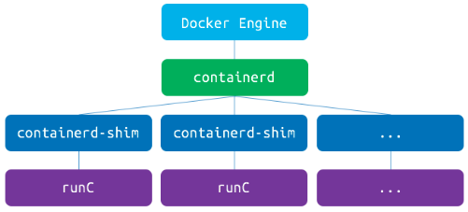
Docker related processes
dockerd: Docker Engine daemon
containered: A lightweight daemon for handling container lifecycle, commands handling.
containerd-shim: A shim process for holding parent owership to (of a containered process) to allow daemon and containered to exit/restart without impact.
runc: the OCI-compliant runtime for executing container processes given a fs bundle and OCI configuration.

Slide 13
Docker related processes
Build & run a C application using Docker
1.
lou@vostro:~$ docker ps
CONTAINER ID IMAGE COMMAND CREATED STATUS PORTS NAMES
c09722e70098 time_display "/bin/sh -c /timeDis…" 4 seconds ago Up 3 seconds friendly_cerf
2.
lou@vostro:~/101/docker$ ps faux | less
…
root 1805056 0.0 0.0 1236472 11088 ? Sl 09:32 0:00 /usr/bin/containerd-shim-runc-v2 -namespace moby -id c09722e7009809abb321701763d322b9e21628b6b68c879670585538ee2dfd56 -address /run/containerd/containerd.sock
root 1805084 0.0 0.0 2800 1664 pts/0 Ss+ 09:32 0:00 \_ /bin/sh -c /timeDisplay
root 1805108 0.0 0.0 2680 1536 pts/0 S+ 09:32 0:00 \_ /timeDisplay

Slide 14
Docker images
Image = files + metadata
These files form the root filesystem of our container.
The metadata can indicate a number of things, e.g.:
the author of the image
the command to execute in the container when starting it
environment variables to be set
etc.
Notes:
Q1: What are differences between ubuntu Docker image & ubuntu OS ? The statment FROM ubuntu:14.04 means use the ubuntu image as a base image. The ubuntu image is not an OS. This image "mimics" an Ubuntu OS, in the sense that it has a very similar filesystem structure to an Ubuntu os and has many tools available that are typically found on Ubuntu.
The main and fundamental difference is that the Docker Ubuntu image does not have it own linux kernel. It uses the kernel of the host machine where the container is running.
Q2: How are base images being built?
To create a distribution base image, you can use a root filesystem, packaged as a tar file, and import it to Docker with docker import .

Slide 15
Docker images
Listing Docker image:
lou@vostro:~/101/docker/compileC$ docker image ls
REPOSITORY TAG IMAGE ID CREATED SIZE
time_display latest fc1617c8381b 8 minutes ago 456MB
words latest f559126b4acc 18 hours ago 429MB
web latest b483f25ae404 19 hours ago 897MB
db latest 9592f8815e1c 19 hours ago 432MB

Slide 16
Docker layers
Images are made of layers, conceptually stacked on top of each other.
Each layer can add, change, and remove files and/or metadata.
Images can share layers to optimize disk usage, transfer times, and memory use.

Slide 17
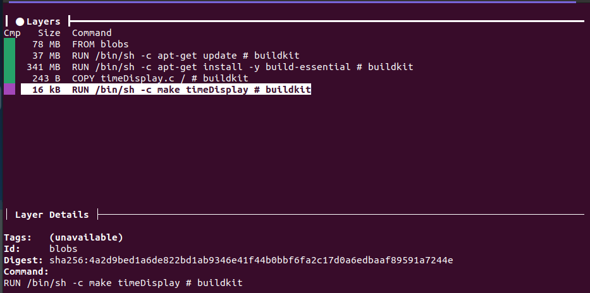
Docker layers

Slide 18
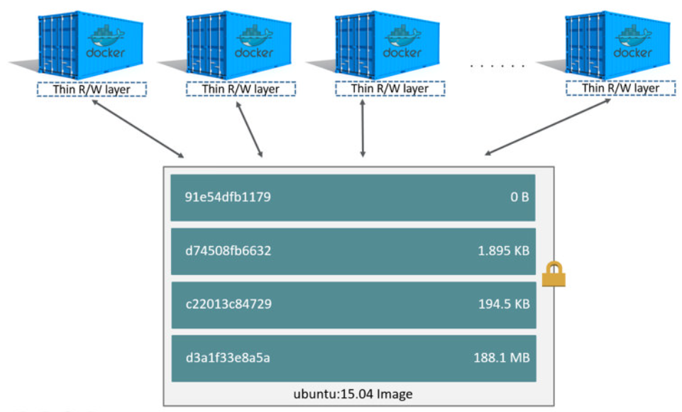
Multiple containers sharing the same images

Slide 19
Building Docker images with a Dockerfile
A Dockerfile is a build recipe for a Docker image.
It contains a series of instructions telling Docker how an image is constructed.
The docker build command builds an image from a Dockerfile.

Slide 20
Dockerfile
FROM ubuntu
RUN apt-get update
RUN apt-get install -y build-essential
COPY timeDisplay.c /
RUN make timeDisplay
CMD /timeDisplay
FROM indicates the base image for our build.
Each RUN line will be executed by Docker during the build
COPY to place the source file into the container.
CMD will define the default parameter(s) for this command

Slide 21
Let’s build it
lou@vostro:~/101/docker/compileC$ docker build --no-cache -t time_display .
[+] Building 40.3s (10/10) FINISHED docker:default
=> [internal] load build definition from Dockerfile 0.0s
=> => transferring dockerfile: 168B 0.0s
=> [internal] load metadata for docker.io/library/ubuntu:latest 0.0s
=> [internal] load .dockerignore 0.0s
=> => transferring context: 2B 0.0s
=> CACHED [1/5] FROM docker.io/library/ubuntu:latest 0.0s
=> [internal] load build context 0.0s
=> => transferring context: 35B 0.0s
=> [2/5] RUN apt-get update 11.6s
=> [3/5] RUN apt-get install -y build-essential 27.6s
=> [4/5] COPY timeDisplay.c / 0.0s
=> [5/5] RUN make timeDisplay 0.4s
=> exporting to image 0.7s
=> => exporting layers 0.7s
=> => writing image sha256:e61e3578fba7b3d1e09928b0141f78d32885ff998aabaab8f919e16568a78f75 0.0s
=> => naming to docker.io/library/time_display 0.0s
Notes:
Build is caching process.

Slide 22
Docker relating to OOP concepts
Dockerfile are conceptually similar to real object.
Images are conceptually similar to classes.
Layers are conceptually similar to inheritance.
Containers are conceptually similar to instances.

Slide 23
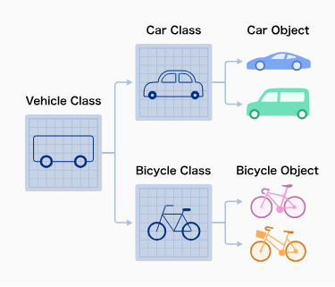
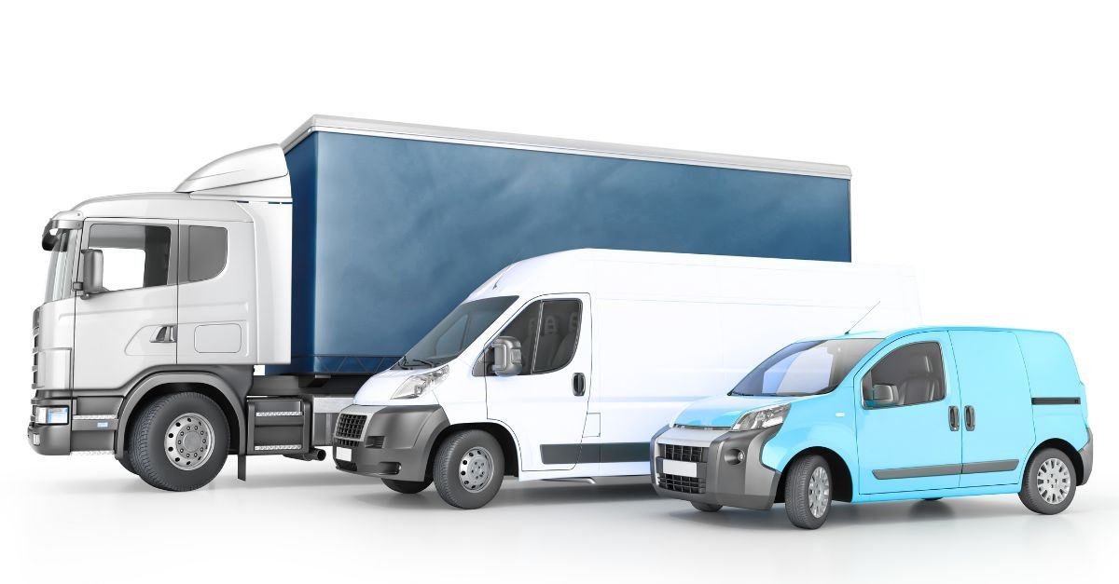
Docker relating to OOP concepts
Dockerfile
images
layers
containers

Slide 24

Understanding volumes
Conceptually, a Docker "network" is a virtual switch (VLAN, WiFi SSID for instance)
Example: Running a NGINX server
lou@vostro:~/101/docker$ docker run -d -P nginx
bb5801b5aa8d5403f61533086795a3c35e61e876c02e8060cd5e2fa7b3304f9d
lou@vostro:~/101/docker$
lou@vostro:~/101/docker$ docker ps | grep nginx
bb5801b5aa8d nginx "/docker-entrypoint.…" 13 seconds ago Up 13 seconds 0.0.0.0:32770->80/tcp, :::32770->80/tcp xenodochial_feynman
lou@vostro:~/101/docker$

Slide 25
Docker network
Conceptually, a Docker "network" is a virtual switch (VLAN, WiFi SSID for instance)
Example: Running a NGINX server
lou@vostro:~/101/docker$ docker run -d -P nginx
bb5801b5aa8d5403f61533086795a3c35e61e876c02e8060cd5e2fa7b3304f9d
lou@vostro:~/101/docker$
lou@vostro:~/101/docker$ docker ps | grep nginx
bb5801b5aa8d nginx "/docker-entrypoint.…" 13 seconds ago Up 13 seconds 0.0.0.0:32770->80/tcp, :::32770->80/tcp xenodochial_feynman
lou@vostro:~/101/docker$

Slide 26
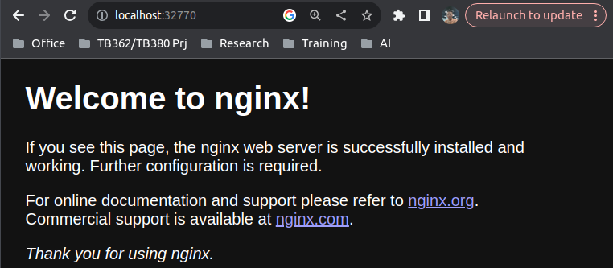
Docker network
Running a NGINX server

Slide 27
Container Network drivers
Each network is managed by a driver.
The built-in drivers include:
bridge (default)
null (for the special network called none)
host (for the special network called host)
container (that one is a bit magic!)
The network is selected with docker run --net ...
Notes:
No direct communication between containers belong to different networks.

Slide 28
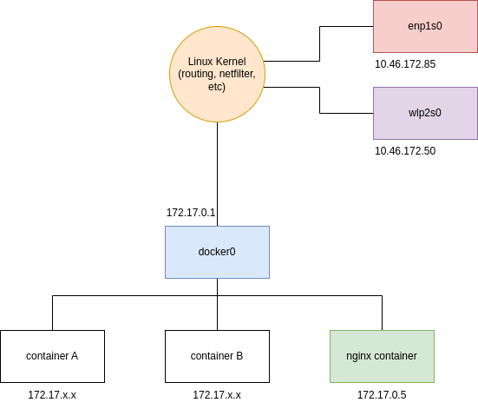
Inspect a NGINX server networking
We can manage them with the docker network commands; for instance:
docker network ls

Slide 29
Inspect a NGINX server networking
Bridge
lou@vostro:~/101/docker$ ifconfig docker0
docker0: flags=4163<UP,BROADCAST,RUNNING,MULTICAST> mtu 1500
inet 172.17.0.1 netmask 255.255.0.0 broadcast 172.17.255.255
inet6 fe80::42:d0ff:fe9d:ec5d prefixlen 64 scopeid 0x20<link>
ether 02:42:d0:9d:ec:5d txqueuelen 0 (Ethernet)
RX packets 49816 bytes 3218578 (3.2 MB)
RX errors 0 dropped 0 overruns 0 frame 0
TX packets 67540 bytes 392001010 (392.0 MB)
TX errors 0 dropped 0 overruns 0 carrier 0 collisions 0

Slide 30
Inspect a NGINX server networking
Container
lou@vostro:~/101/docker$ docker inspect bb5801b5aa8d -f "{{json .NetworkSettings.Networks.bridge.Gateway }}"
"172.17.0.1"
lou@vostro:~/101/docker$ docker inspect bb5801b5aa8d -f "{{json .NetworkSettings.Networks.bridge.IPAddress }}"
"172.17.0.5"
lou@vostro:~/101/docker$

Slide 31
Inspect a NGINX server networking
Routing tables
lou@vostro:~/101/docker$ ip route
default via 10.46.173.254 dev enp1s0 proto dhcp metric 100
default via 10.46.173.254 dev wlp2s0 proto dhcp metric 20600
10.46.172.0/23 dev enp1s0 proto kernel scope link src 10.46.172.85 metric 100
10.46.172.0/23 dev wlp2s0 proto kernel scope link src 10.46.172.50 metric 600
172.17.0.0/16 dev docker0 proto kernel scope link src 172.17.0.1

Slide 32
Inspect a NGINX server networking
Iptables
lou@vostro:~/101/docker$ sudo iptables -S -t nat
-P PREROUTING ACCEPT
-P INPUT ACCEPT
-P OUTPUT ACCEPT
-P POSTROUTING ACCEPT
-N DOCKER
-A PREROUTING -m addrtype --dst-type LOCAL -j DOCKER
-A OUTPUT ! -d 127.0.0.0/8 -m addrtype --dst-type LOCAL -j DOCKER
-A POSTROUTING -s 172.17.0.0/16 ! -o docker0 -j MASQUERADE
-A POSTROUTING -o enp1s0 -j MASQUERADE
-A POSTROUTING -s 172.17.0.5/32 -d 172.17.0.5/32 -p tcp -m tcp --dport 80 -j MASQUERADE
-A DOCKER -i docker0 -j RETURN
-A DOCKER ! -i docker0 -p tcp -m tcp --dport 32770 -j DNAT --to-destination 172.17.0.5:80
Notes:
Outbound traffic goes through an iptables MASQUERADE rule
Inbound traffic goes through an iptables DNAT rule

Slide 33
Not mentioned
Docker Compose: Defining and running multi-container applications.
Docker registry/ Docker Hub: same energy as “Git/Github”
Docker Machine: a tool to provision and manage Docker hosts.
Deep dive into container internals: How containers work under the hood.
…

Slide 34
Thank You

